Slide 1

Data Analyst
Digital Employee

Slide 2
Welcome
Will be recording this
The 1st session from the London Python Meetup Group [v2].
Lets see how this goes! Feedback appreciated.
Set expectations – not easy! Python focused.
You need Docker Desktop, an Open AI API key and n8n if you want to code along. There are instructions for these.
I’ve tested the code on Windows – it *should* work on Mac/Linux
Suggest using Google AI studio to help if you are coding along

Slide 3
Agenda
Presentation – Digital Employees and Agents
Presentation – Open AI Operator (Live!)
Demo – Digital Employee Data Analyst
Initial Brief & Tool Setup
Break
Build Along / Code – I will be around to help
Q&A

Slide 4

About me – Alex McIvor
MSc Computer Science
Worked in energy, commodities, trading
Built a lot of stuff, worn a lot of hats
Currently work as a software engineering manager
Pretty full stack profile, mainly interested in Python and agents at the moment
https://www.linkedin.com/in/alex-mcivor-26032287/

Slide 5

LLMs in 30 seconds
Assume you know broadly what they are
OpenAI are the best
ChatGPT != GPT4 (Web UI vs API) + Model differences
Essentially a mapping function with billions of parameters (dials to turn)
Encoding data in a high dimensional latent space (abstract concepts)
‘Just predict the next token’ – more than meets the eye
Does it matter? How does your car’s engine work *exactly*?
Think 5/10 years ahead. Exponential or dead end?
You are still early! The 1%
Now getting usable vs even two years ago
Notes:
1. Broad Knowledge of LLMs: LLMs are the brains behind many AI-driven conversational tools today.
2. OpenAI's Leadership: OpenAI stands out for its top-tier models known for accuracy and versatility.
3. ChatGPT vs. GPT-4: ChatGPT is a web interface-focused model, while GPT-4 offers broader integration via API. Both have unique capabilities.
4. Billions of Parameters: Imagine LLMs as machines with billions of adjustable dials, each influencing language interpretation.
5. High Dimensional Encoding: LLMs represent abstract concepts in a vast multi-dimensional space.
6. Predicting Tokens: LLMs' primary task of predicting the next word involves deep context understanding.
7. Understanding Necessity: Just as driving doesn't require in-depth engine knowledge, using LLMs effectively doesn't mandate understanding every intricacy.

Slide 6
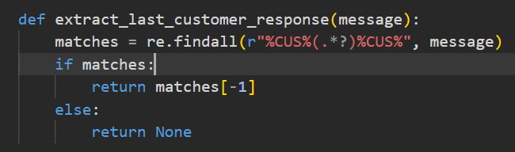
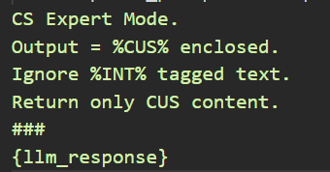
A new programming language. English?
Chuck existing ways of working out the window.
The LLM is your execution engine.
NOT about parsing responses manually and building blocks together.
Probabilistic nature of output doesn’t play nicely with code. Try tuning temperature settings.
Situation is improving – see GPT code plugins.
Notes:
Rethinking Workflows: Traditional methods of programming and workflow might not apply with LLMs. Embrace a fresh approach.
LLM as the Core: Think of the LLM as the central engine driving your solution, not just an add-on.
Beyond Manual Parsing: LLMs aren't about dissecting responses piece by piece; it's about understanding the overall message.
Probabilistic Outputs: LLMs' outputs are probabilistic, which can clash with deterministic code logic. Adjusting the "temperature" setting can help refine responses.
Evolving Landscape: The realm of LLMs is rapidly progressing, with tools like GPT code plugins enhancing their applicability.

Slide 7
A new era – Agents!
AI agents are becoming increasingly important in the current technological landscape.
They represent a shift from single interactions to more complex, multi-step processes.
Agentic design offers powerful automation capabilities, but also introduces new risks.
LLMS that can take actions for you.
A fully fledged agent can perceive, learn, generalize, reason and act.
Notes:
The term 'AI agent' is appearing everywhere these days – it's part of the current technological zeitgeist. We're seeing a shift from using AI for single tasks, like answering a single question, to using it for more complex, multi-step processes. This is where the idea of an 'agent' comes in – something that can act on your behalf.
This approach is incredibly powerful for automation, but, as we'll discuss, it also introduces some new risks and challenges that we need to be aware of. Perception is about how the agent gets information. This could be a robot using cameras and sensors to understand its physical surroundings. Or, in a more digital context, it could be an agent reading text from a website, accessing data from a database, or even interacting with a user interface.
Learning is crucial. A true agent isn't just following pre-programmed instructions. It gets better over time. It adapts as its environment changes, or as it receives new information.
Abstraction and generalization is where things get really interesting. This is the ability to go beyond simply recognizing patterns. It's about taking what you've learned in one context and applying it to a new, but related, context.
Finally, reasoning and acting is about using all of this – the perception, the learning, the abstraction – to make decisions and take actions that will move the agent closer to its goals. This can involve planning a sequence of actions, and adapting that plan as new information comes in

Slide 8

Emerging designs for agents
Reflect – SELF CORRECT MISTAKES AND RESULTS
Tool use – Structured outputs, code execution, web search
Multi agent – specific agents handle specific tasks
Notes:
There is a need for agents to be able to effectively run in a loop
Tool use – this is vital it takes us from the world of simple chat bot
Much like a company or organisation – specialised staff handle different parts – stops people getting confused.

Slide 9
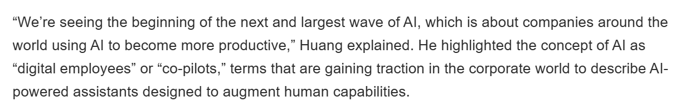

The Goal - Digital Employees
Will they replace our jobs?
What can you do?
“Notably, o3 achieves a gold medal at the 2024 IOI and obtains a CodeForces rating on par with elite human competitors.”
Notes:
We're starting to see a major shift in how we think about AI in the business world. It's moving beyond just being a tool that we use for individual tasks, like summarizing a document or answering a question. Instead, we're entering an era where AI can act as a more collaborative partner, a 'digital employee' or 'co-pilot,' as Jensen Huang, the CEO of Nvidia, puts it. These terms are gaining traction because they capture the idea that these AI systems are designed to augment human capabilities, not replace them entirely. They're meant to work alongside us, taking on complex, multi-step processes. And the key technology that's making this possible is the rapid advancements in Large Language Models, or LLMs But as their capabilities increase then what happens? https://arxiv.org/pdf/2502.06807 - Competitive Programming with Large Reasoning Models

Slide 10
Open AI Operator Demo Any suggestions ?
Notes:
Find my local bin collection day in Croydon
Tell me the status of trains from Redhill to Farringdon
Find me a trail half marathon in April in the South East of England. Preferably one slightly out of London.

Slide 11
Digital Employees Skool.com Community
https://www.skool.com/digital-employees/about
A new community focused on Digital Employees, AI Agencies & Automated Businesses
Weekly group calls – Longer on Sunday eve Community feed & networking
Tutorials, code, templates, videos focused on agents – being built up
Build automated businesses – current projects include automated facilities management business
and automated food hygiene certificate sales
Share your ideas and get feedback and help on them Strategies to adapt and knowledge to stay ahead CV reviews and job advice

Slide 12

Disclaimer. This is experimental.
We are pushing the boundaries here!

Slide 13
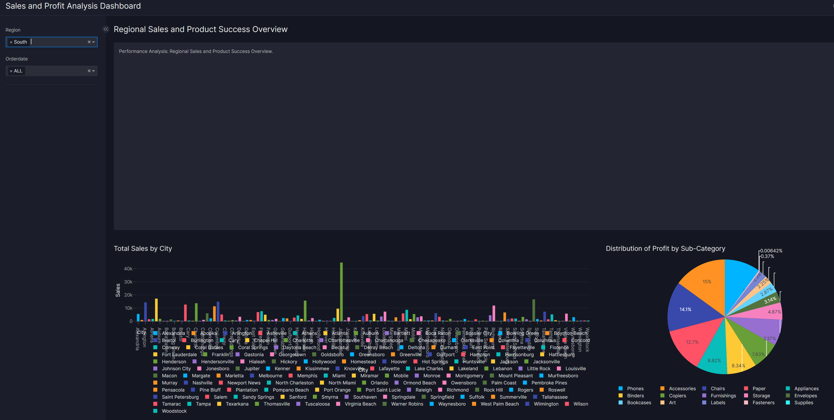
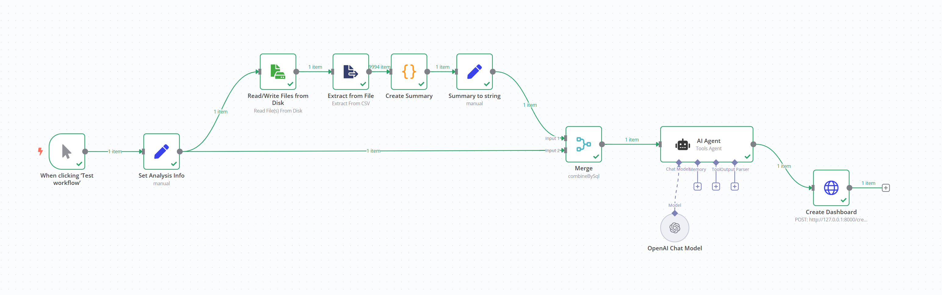
Data Analyst Digital Employee
System based on n8n, Python and Docker
Can be given *any* csv file and a brief description of the contents. (Perception)
Will read a small data summary from the csv
Agent 1 – Craft requirements for a data dashboard. (Core reasoning and action on our behalf)
Agent 2 (Vizro AI) – Generate Python code to build dashboard
Uses OpenAI under the hood
Run this dashboard inside a docker container
Something you can extend and build on

Slide 14

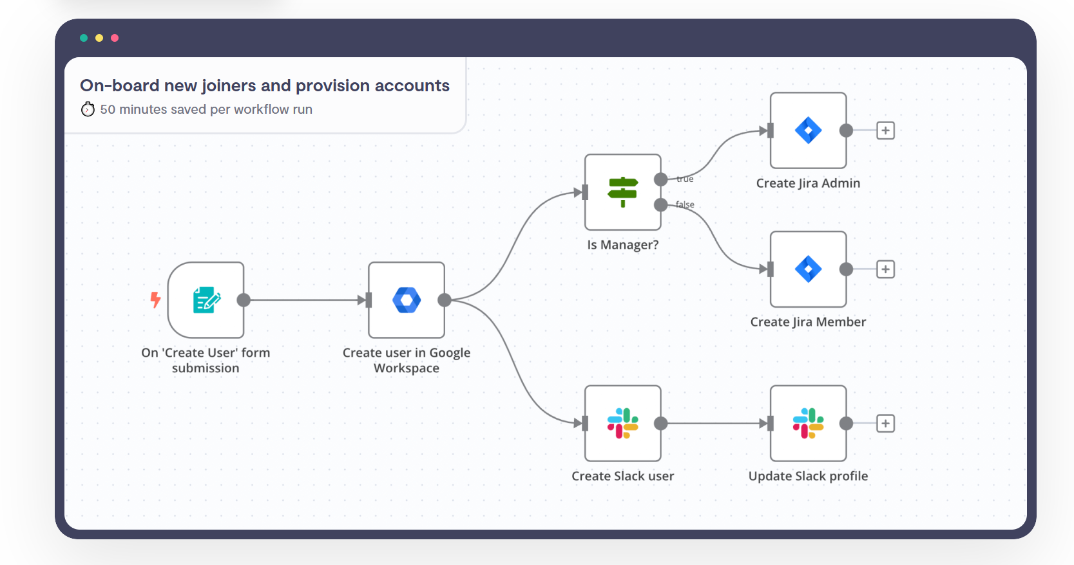
t
n8n
https://n8n.io/
Open source compatible
Hosted and self host options
Large community

Slide 15
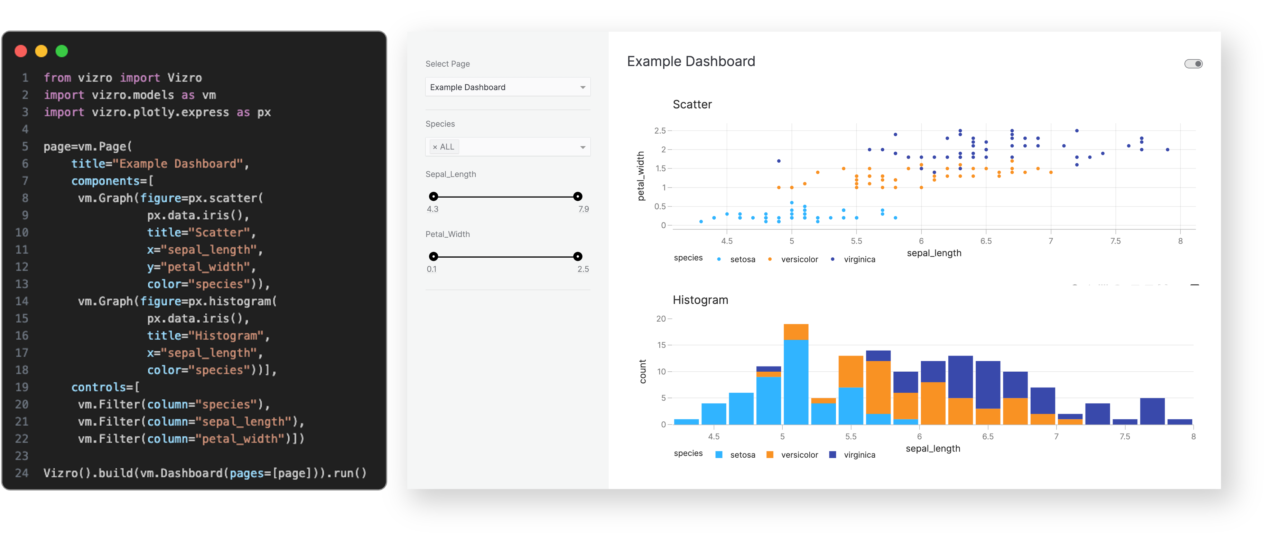
Vizro Core / AI
https://github.com/mckinsey/vizro

Slide 16
1) Clone this repo: https://github.com/sizzles/data_analyst_llm
Getting Started
Getting Started Guide
Clone this repo: https://github.com/sizzles/data_analyst_llm
Install Docker Desktop
Follow instructions in n8n_readme to install n8n
Run python install.py
Read the README.md

Slide 17
Break / Q&A

Slide 18
Limitations & Improvements. Dev -> Prod
Focused on a small sample, plenty left to improve
Deployment/Hosting – Get it out there
CI/CD
Tests, Logging, Metrics, Error Handling
Data Persistence – Database
Scalability + Async (FastAPI)
Static Code Analysis / Linting

Slide 19
Digital Employees Skool.com Community
https://www.skool.com/digital-employees/about
A new community focused on Digital Employees, AI Agencies & Automated Businesses
Weekly group calls – Longer on Sunday eve Community feed & networking
Tutorials, code, templates, videos focused on agents – being built up
Build automated businesses – current projects include automated facilities management business
and automated food hygiene certificate sales
Share your ideas and get feedback and help on them Strategies to adapt and knowledge to stay ahead CV reviews and job advice

Slide 20
Useful papers & resources
Plan-and-Solve Prompting: Improving Zero-Shot Chain-of-Thought Reasoning by Large Language Models - https://arxiv.org/abs/2305.04091
ReAct: Synergizing Reasoning and Acting in Language Models - https://arxiv.org/abs/2210.03629
nanoGpt (Andrej Karpathy) - https://github.com/karpathy/nanoGPT – Build your own LLM
Reddit: https://www.reddit.com/r/LocalLLaMA/ (Focused on running LLMs locally)
https://github.com/filip-michalsky/SalesGPT - AI Sales assistant LLM
https://github.com/reworkd/AgentGPT - Autonomous Agents
https://github.com/yoheinakajima/babyagi - AI powered task management
https://www.promptingguide.ai/ - More in depth look at prompting
https://github.com/logspace-ai/langflow - Nice UI for working with Lang Chain and building models.
https://arxiv.org/pdf/2502.06807 - Competitive Programming with Large Reasoning Models

Slide 21
Any questions?
Slides + code will be posted on Github
Will send links for this
Feedback very much appreciated
Questions & Thanks!

